Slide 1
Data Structures ICT-1211 Information and Communication Technology
Lecture-28
Date: //2024

Slide 2
Graph

Slide 3
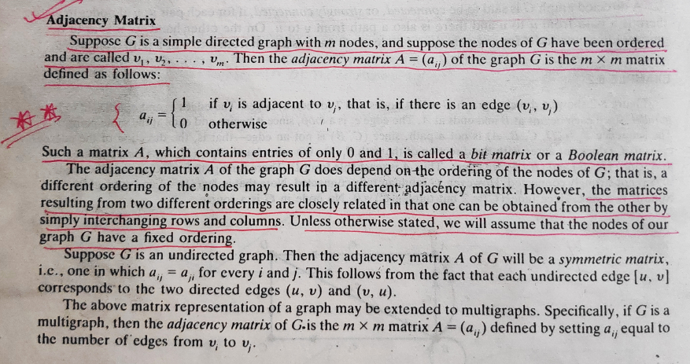
Graphs

Slide 4
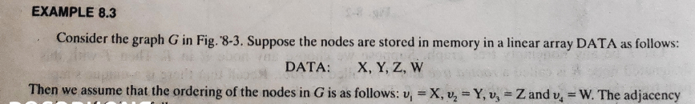
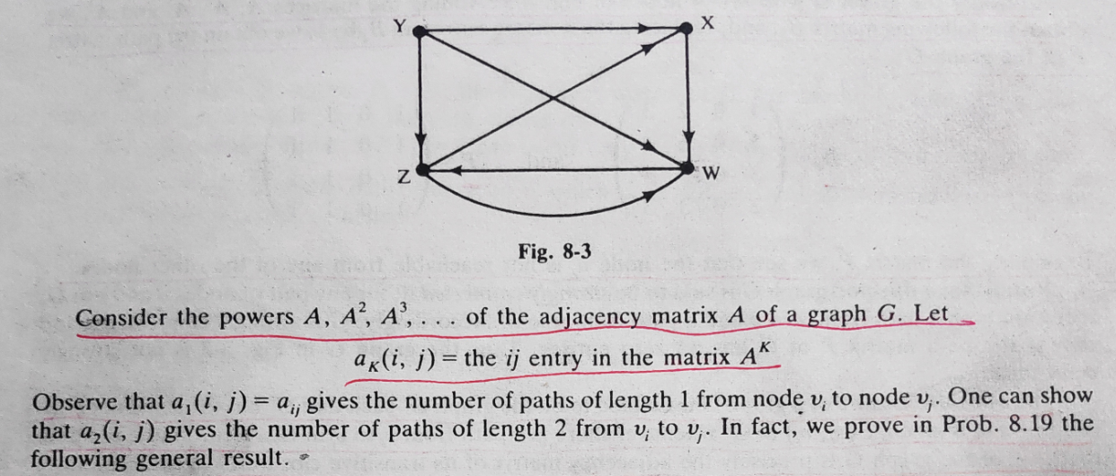
Graphs

Slide 5
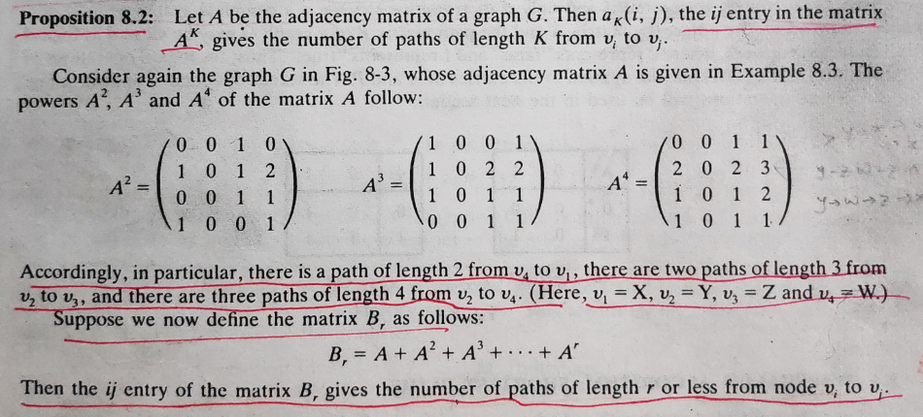
Graphs

Slide 6
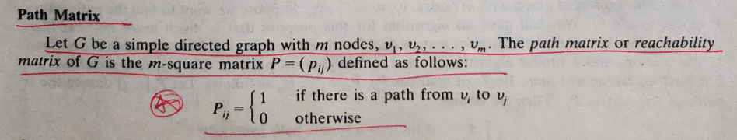
Graphs

Slide 7
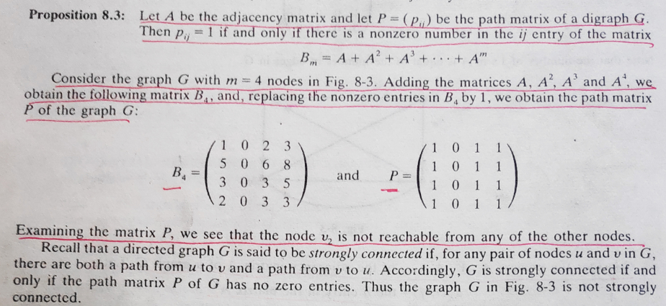
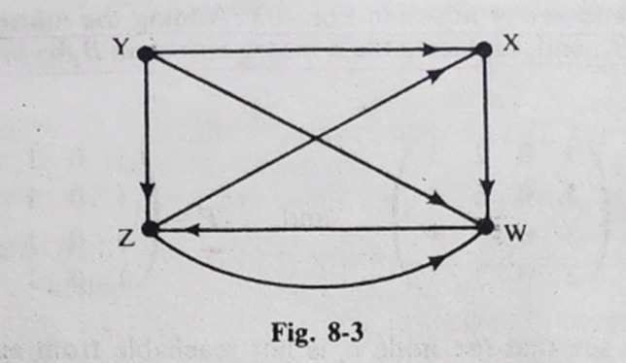
Graphs

Slide 8
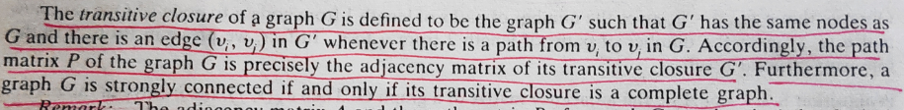
Graphs

Slide 9
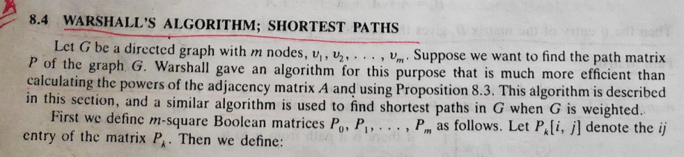
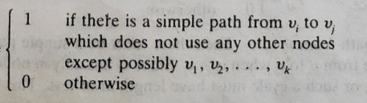
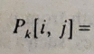
Graphs

Slide 10
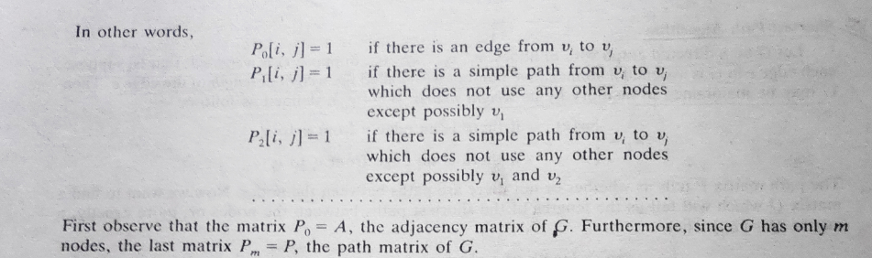
Graphs

Slide 11
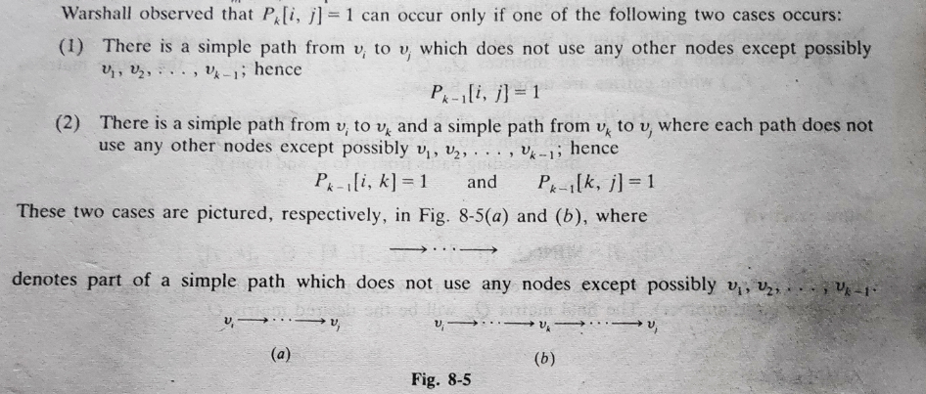
Graphs

Slide 12
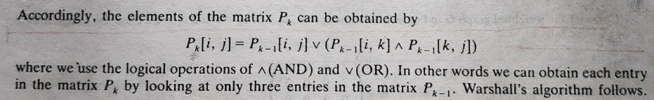
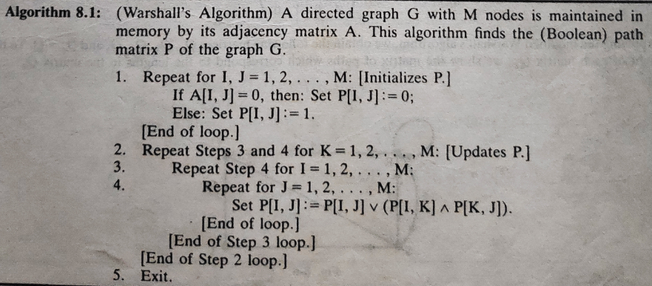
Graphs

Slide 13
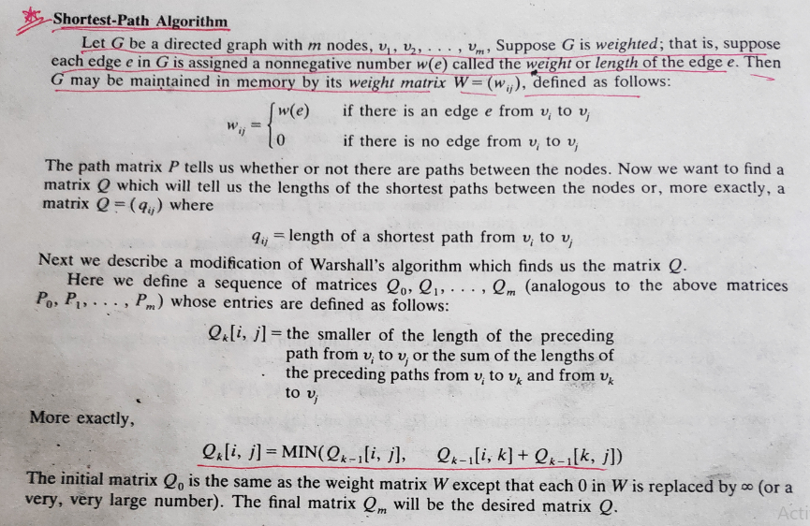
Graphs

Slide 14
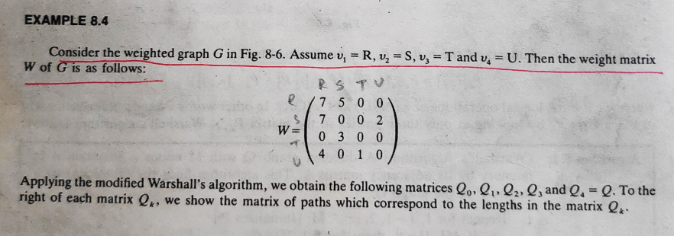
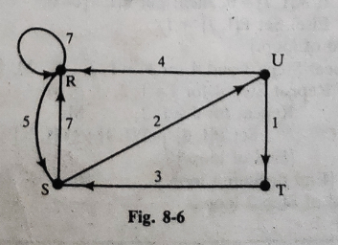
Graphs

Slide 15
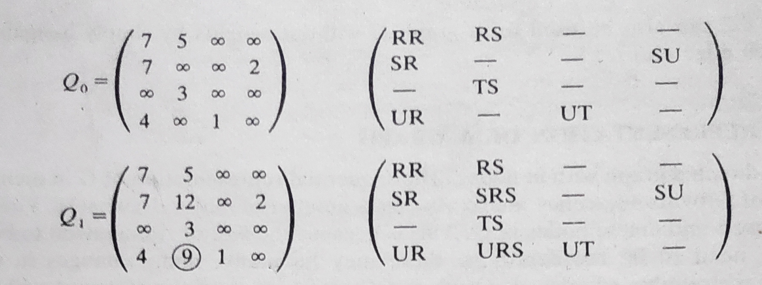
Graphs

Slide 16
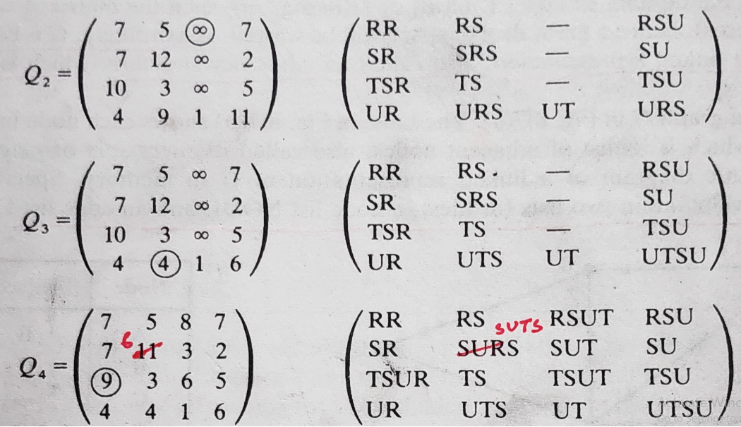
Graphs

Slide 17
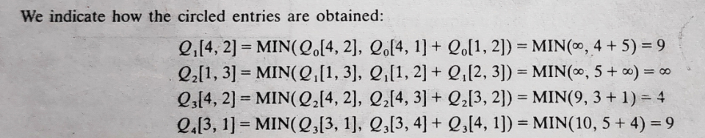
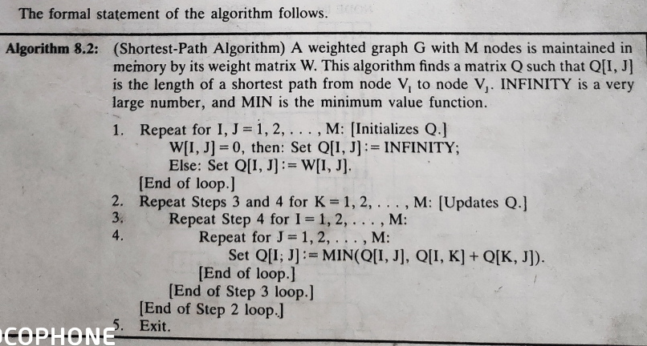
Graphs

Slide 18
Floyd Warshall Algorithm
Let’s go over the premise of how Floyd-Warshall algorithm works…
Let the vertices in a graph be numbered from 1 … n.
Consider the subset {1,2,…, k} of these n vertices.
Imagine finding the shortest path from vertex i to vertex j that uses vertices in the set {1,2,…,k} only.
There are two situations:
k is an intermediate vertex on the shortest path.
k is not an intermediate vertex on the shortest path.
k
i
j

Slide 19
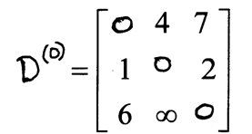
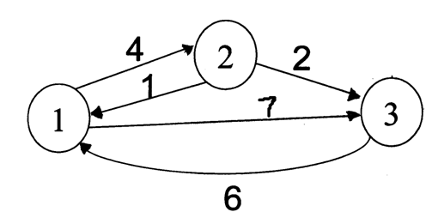
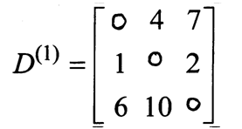
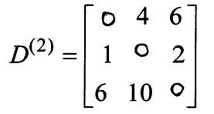
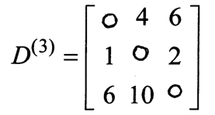
Floyd Warshall Algorithm - Example
Original weights.
Consider Vertex 1:
D(3,2) = D(3,1) + D(1,2)
Consider Vertex 2:
D(1,3) = D(1,2) + D(2,3)
Consider Vertex 3:
Nothing changes.

Slide 20
Dynamic programming algorithms for all-pairs shortest path and longest common subsequences
We will study a new technique—dynamic programming algorithms (typically for optimization problems)
Ideas:
Characterize the structure of an optimal solution
Recursively define the value of an optimal solution
Compute the value of an optimal solution in a bottom-up fashion (using matrix to compute)
Backtracking to construct an optimal solution from computed information.

Slide 21
Floyd-Warshall algorithm for shortest path:
Use a different dynamic-programming formulation to solve the all-pairs shortest-paths problem on a directed graph G=(V,E).
The resulting algorithm, known as the Floyd-Warshall algorithm, runs in O (V³) time.
negative-weight edges may be present,
but we shall assume that there are no negative-weight cycles.

Slide 22
The structure of a shortest path:
We use a different characterization of the structure of a shortest path than we used in the matrix-multiplication-based all-pairs algorithms.
The algorithm considers the “intermediate” vertices of a shortest path, where an intermediate vertex of a simple path p=<v₁,v₂,…,v_{l}> is any vertex in p other than v₁ or v_{l}, that is, any vertex in the set {v₂,v₃,…,v_{l-1}}

Slide 23
Continue:
Let the vertices of G be V={1,2,…,n}, and consider a subset {1,2,…,k} of vertices for some k.
For any pair of vertices i,j ∈ V, consider all paths from i to j whose intermediate vertices are all drawn from {1,2,…,k},and let p be a minimum-weight path from among them.
The Floyd-Warshall algorithm exploits a relationship between path p and shortest paths from i to j with all intermediate vertices in the set {1,2,…,k-1}.

Slide 24
Relationship:
The relationship depends on whether or not k is an intermediate vertex of path p.
If k is not an intermediate vertex of path p, then all intermediate vertices of path p are in the set {1,2,…,k-1}. Thus, a shortest path from vertex i to vertex j with all intermediate vertices in the set {1,2,…,k-1} is also a shortest path from i to j with all intermediate vertices in the set {1,2,…,k}.
If k is an intermediate vertex of path p,then we break p down into i k j as shown Figure 2.p1 is a shortest path from i to k with all intermediate vertices in the set {1,2,…,k-1}, so as p2.

Slide 25
All intermediate vertices in {1,2,…,k-1}
p1
k
p2
i
j
P:all intermediate vertices in {1,2,…,k}
Figure 2. Path p is a shortest path from vertex i to vertex j,and
k is the highest-numbered intermediate vertex of p. Path p1,
the portion of path p from vertex i to vertex k,has all intermediate
vertices in the set {1,2,…,k-1}.The same holds for path p2 from
vertex k to vertex j.

Slide 26
A recursive solution to the all-pairs shortest paths problem:
Let d_{ij}^{(k)} be the weight of a shortest path from vertex i to vertex j with all intermediate vertices in the set {1,2,…,k}. A recursive definition is given by
d_{ij}^{(k)}= w_{ij} if k=0,
min(d_{ij}^{(k-1)},d_{ik}^{(k-1)}+d_{kj}^{(k-1)}) if k 1.
The matrix D^{(n)}=(d_{ij}^{(n)}) gives the final answer-d_{ij}^{(n)}= for all i,j V-because all intermediate vertices are in the set {1,2,…,n}.

Slide 27
Computing the shortest-path weights bottom up:
FLOYD-WARSHALL(W)
n rows[W]
D⁽⁰⁾ W
for k 1 to n
do for i 1 to n
do for j 1 to n
d_{ij}^{(k)} min(d_{ij}^{(k-1)},d_{ik}^{(k-1)}+d_{kj}^{(k-1)})
return D^{(n)}

Slide 28
Example:
Figure 3
2
4
3
1
3
8
1
-4
-5
7
2
5
4
6

Slide 29
D(0)=
(0)=
D(1)=
(1)=

Slide 30
D(2)=
(2)=
D(3)=
(3)=

Slide 31
D(4)=
(4)=
D(5)=
(5)=

Slide 32
Thank you……

